Slide 1
Mobile Application Dev
SCS 2210
Lecture 2: Principles of Mobile App Design and Development

Slide 2
2.1 Mobile Application Architecture
What is Mobile Application Architecture?
It is a set of structural elements and their interfaces from which the system is composed. Based on them, well-structured and user-friendly mobile apps can be designed.
Before getting down to writing code, it is essential to get a clear idea of what features should be built into your app so that it will meet customer needs. Once they are explicitly defined, you can design the mobile architecture for your app.
The complexity of building high-quality architecture depends on the size of the application. The proper architecture will allow for saving a lot of time, energy, and costs in the future.
Things To Consider While Designing A Mobile Architecture Diagram
Gadget Characteristics
The Speed Of Internet Connection
Application Users (UI and Navigation Method)
A Mobile Operating System

Slide 3
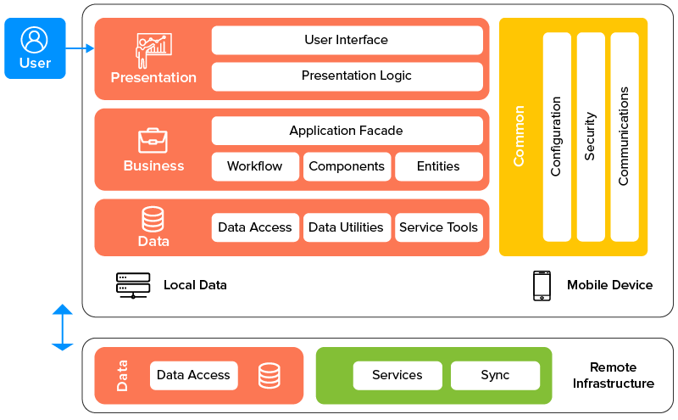
2.1 Mobile Application Architecture continued…
The Three Layers of Mobile App Development Architecture
When it comes to the specifics of building an app, everything starts from these fundamental layers:
1. Data layer — the data-related platform within a mobile app
2. Business logic layer — the place for all the domain processes and operations
3. Presentation layer — all the technical details connected with the user interface
Figure 2.1 Layers of Mobile App

Slide 4
2.1 Mobile Application Architecture continued…
The Key Mobile Application Architecture Principles
A good mobile app architecture best practices (both Android mobile app architecture and iOS application architecture) is the one which enforces good programming patterns and assumptions.
Meeting all these different conditions enables you to speed up the development process while making maintenance much easier.
The following principles can be followed by developers:
Portability: - It is the system’s ability to react to the changing environment
Maintainability: - ensure high maintainability while reducing the efforts needed to keep the system up and running
Reusability: - components and protocols can be reused during updates or at redesign
Security: - Data security is the most major non-functional need of an application
Performance: - Users expect applications to be quick and issues free

Slide 5
2.2 Mobile App Design Guidelines
Introduction
The difference between a good app and a bad app is usually the quality of its user experience (UX). A good UX is what separates successful apps from unsuccessful ones. Today, mobile users expect a lot from an app: fast loading time, ease of use and delight during interaction. If you want your app to be successful, you have to consider UX to be not just a minor aspect of design, but an essential component of product strategy.
Some of what to consider when designing for mobile
1. Provide Simple Navigation
Simple navigation provides an obvious way of moving between screens and finding the desired items as mobile users must go and forth within the same window.
2. Make Large Touch Area
Make sure to design control sizes that are easier to tap using the thumb. Providing smaller controls will annoy the user when he uses your app.
3. Reduce Clutter
Organize your content in a way that provides the user with a clear understanding of the available features. Reduce clutter and keep minimum content on screen.

Slide 6
2.2 Mobile App Design Guidelines continued…
What to consider when designing for mobile
4. Display Large Text
Keep in mind the smaller size of the mobile screen and make your text larger in size so that it can be easier to read and understand.
5. Use Touch Controls
A lot of mobile controls are available to use in design. It is not a good idea to use simple web controls as it is difficult to interact with them on mobile.
6. Use Simple Forms
Try to provide simpler forms where users can provide their input with ease. Use form controls where typing the text is minimum.
7. Take Care of Thumb Position
Design screen layout while researching on thumb-friendly zones. Provide tapping controls at a place where users can easily tap them using his thumb.
8. Design Consistent Experience
If your site/app is present at both web and mobile, provide a consistent experience to the user. Minimize your content on small devices by keeping the experience similar to other devices.

Slide 7
2.2 Mobile App Design Guidelines continued…
Android vs iOS App Design Guidelines
Android app design follows Material Design whilst iOS app design follows Human Interface Guidelines.
Material Design Guidelines (Android app)
Material design is a comprehensive guide for visual, motion, and interaction design across platforms and devices. To use material design in your Android apps, follow the guidelines defined in the material design specification and use the new components and styles available in the material design support library.
Android provides the following features to help you build material design apps:
A material design app theme to style all your UI widgets
Widgets for complex views such as lists and cards
New APIs for custom shadows and animations

Slide 8
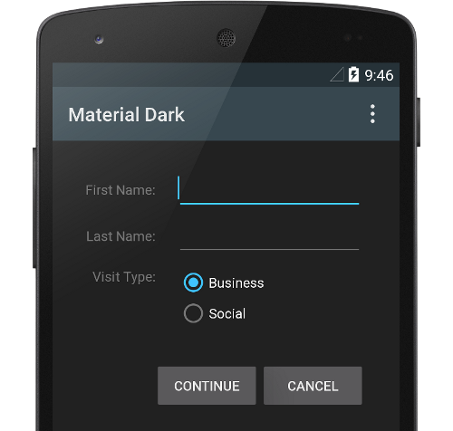
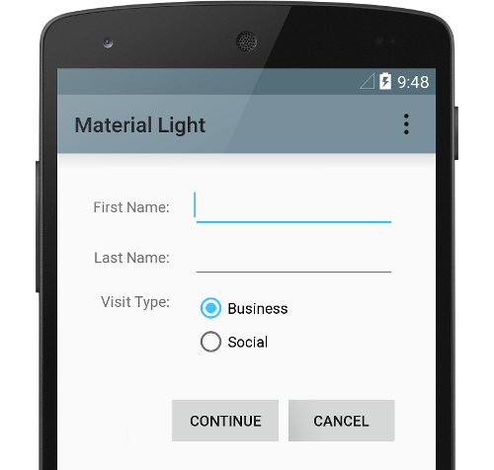
2.2 Mobile App Design Guidelines continued…
1. Material theme and widgets
To take advantage of the material features such as styling for standard UI widgets, and to streamline your app's style definition, apply a material-based theme to your app.
Figure 2.2 Dark material theme
Figure 2.3 Light material theme
To provide your users a familiar experience, use material's most common UX patterns:
Promote your UI's main action with a Floating Action Button (FAB).
Show your brand, navigation, search, and other actions with the App Bar.
Show and hide your app's navigation with the Navigation Drawer.
Use one of many other material components for your app layout and navigation, such as collapsing toolbars, tabs, a bottom nav bar, and more.

Slide 9

2.2 Mobile App Design Guidelines continued…
2. Elevation shadows and cards
In addition to the X and Y properties, views in Android have a Z property. This new property represents the elevation of a view, which determines:
The size of the shadow: views with higher Z values cast bigger shadows.
The drawing order: views with higher Z values appear on top of other views.
Figure 2.4 Elevation shadows
Elevation is often applied when your layout includes a card-based layout, which helps you display important pieces of information inside cards that provide a material look. You can use the CardView widget to create cards with a default elevation.

Slide 10
2.2 Mobile App Design Guidelines continued…
3. Animations
The new animation APIs let you create custom animations for touch feedback in UI controls, changes in view state, and activity transitions
These APIs let you:
Respond to touch events in your views with touch feedback animations.
Hide and show views with circular reveal animations.
Switch between activities with custom activity transition animations.
Create more natural animations with curved motion.
Animate changes in one or more view properties with view state change animations.
Show animations in state list drawables between view state changes.
Touch feedback animations are built into several standard views, such as buttons. The new APIs let you customize these animations and add them to your custom views.

Slide 11
2.2 Mobile App Design Guidelines continued…
Human Interface Guidelines (HIG)_iOS App
As an app designer, you have the opportunity to deliver an extraordinary product that rises to the top of the App Store charts. To do so, you'll need to meet high expectations for quality and functionality.
Three primary themes differentiate iOS from other platforms:
Clarity. Throughout the system, text is legible at every size, icons are precise and lucid, adornments are subtle and appropriate, and a sharpened focus on functionality motivates the design. Negative space, color, fonts, graphics, and interface elements subtly highlight important content and convey interactivity.
Deference. Fluid motion and a crisp, beautiful interface help people understand and interact with content while never competing with it. Content typically fills the entire screen, while translucency and blurring often hint at more. Minimal use of bezels, gradients, and drop shadows keep the interface light and airy, while ensuring that content is paramount.
Depth. Distinct visual layers and realistic motion convey hierarchy, impart vitality, and facilitate understanding. Touch and discoverability heighten delight and enable access to functionality and additional content without losing context. Transitions provide a sense of depth as you navigate through content.

Slide 12
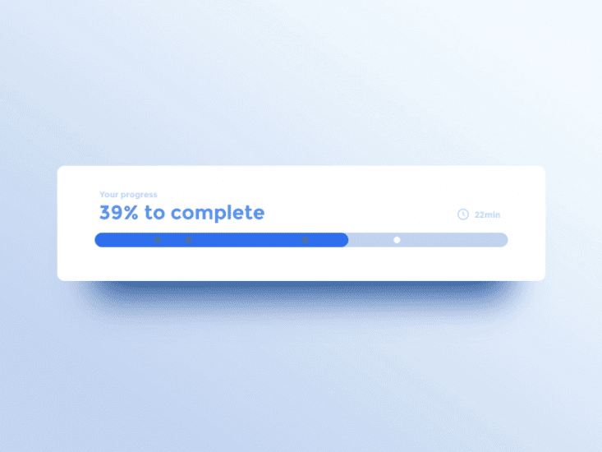
2.2 Mobile App Design Guidelines continued…
HIG Design principles
In HIG, Apple defines the following five basic principles of iOS app design:
Consistency:- A consistent app uses consistent visual and functional language.
Feedback:- Feedback acknowledges actions and shows the results of any operations.

Slide 13
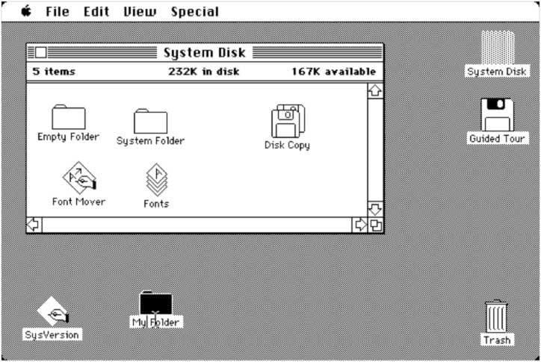
2.2 Mobile App Design Guidelines continued…
Metaphors
An interface metaphor is a UI visual that leverages knowledge users already have from real life. Metaphors allow users to learn more quickly because they can use the knowledge gained from the real-world when interacting with digital products. The most famous metaphor in human-computer interaction and UX design is Alan Kay’s “desktop metaphor”. The desktop metaphor moved us from typing command to direct manipulation with digitally rendered objects.
.

Slide 14

2.2 Mobile App Design Guidelines continued…
Direct manipulation
Users experience direct manipulation when they use gestures to interact with on screen content. Direct manipulation helps users see immediate results of their actions.
.
User control
iOS puts people, not the system, in control. Good iOS design prevents users from making mistakes by suggesting a course of action, but it should never push users in making certain decisions.

Slide 15
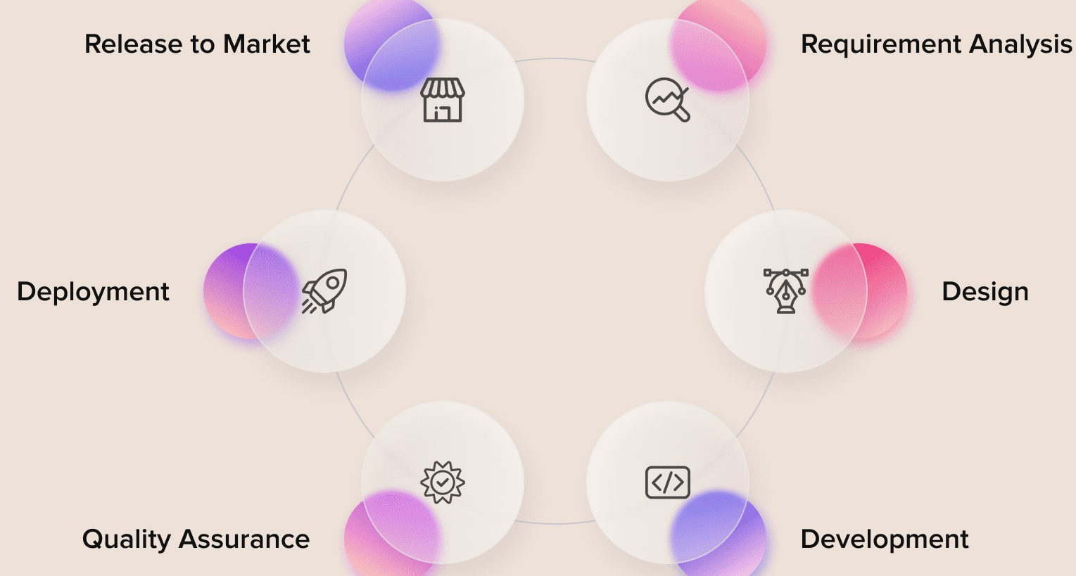
2.3 Mobile App Development Methodologies
What is Software Development Methodology?
A software development methodology is the structuring of processes while working on a project. This refers to the discussion of the design concept, philosophy, and values ​​of the project, as well as general expectations and target audience. A systematic approach to development helps to reduce development time and budgets.
Figure 2.5 Illustration of steps in software development.

Slide 16
2.3 Mobile App Development Methodologies continued..
Benefits of Methodologies in Mobile App Development
Ensure smooth software development as per project requirements.
Helps to plan and build the development process, but it is not responsible for the technical part, so this should be taken care of separately.
Structures the development process and make it logical even when producing a complex product.
Types of Software Development Methodologies
We look at the top methodologies that can be applied in the course of mobile and web development, with their main advantages and disadvantages.
1. Agile Development Methodology
The most flexible and adaptive type of development. Among its main advantages is the possibility of constant changes in the project without sacrificing discipline. All problems are solved through iterations that last from a week to a month.
Agile focuses on the interaction of the entire team with each other and with the customer. This avoids guesswork and inconsistencies in the work on the project.
Disadvantages of the methodology: later there may be problems with the documentation, and in particular cases of large projects, it is difficult to assess the efforts required to implement the project.

Slide 17
2.3 Mobile App Development Methodologies continued..
2. Waterfall Development Methodology
The whole process is represented as a linear sequential flow. At the same time, you can proceed to the next stage only if you are confident in the completion of the previous one. Individual progress, time savings, strict rules, and ease of testing make Waterfall a favorite choice for most teams.
Disadvantages of the methodology: Avoid making edits at the testing stage since there is a risk of destroying the project while drawing up the documentation takes a huge amount of time. Also, the model cannot find out the final result of the project until its completion.
3. Prototype Model
Allows developers to create exclusively prototypes that demonstrate the functionality of a project to the client. This way, you can work through all the scripts and fix bugs before the product is released. With Prototype, you can avoid all the problems that cascading models have.
Disadvantages of the methodology: usually small budgets are allocated on Prototype, in addition, the interest of the client may die out after prototyping. Another negative point is the difficulty in assessing the further scope of work, with the preservation of the development structure.

Slide 18
2.3 Mobile App Development Methodologies continued..
4. Rapid Application Development
Since this involves user participation in the development process, it is much faster. From the client's side, there is a quick and timely analysis of the project and its stages. All this makes RAD an excellent solution to reduce errors in the output.
Disadvantages of the methodology: Requires an extremely modular design of the project and a strong team of skills. Also, RAD requires large budgets, but tracking progress is difficult to report.
5. DevOps Methodology
DevOps is a model in which parts of a project are continuously integrated and deployed. In this way, all operations take place at the same time, ensuring clear interaction between development cycles. Microservices and continuous delivery help accelerate business goals and dramatically improve the final product. DevOps collaboration implies strong accountability and increased responsibility.
Disadvantages of the methodology: the methodology cannot always ensure the speed and safety of the project implementation. In addition, this methodology requires a revision of approaches not only to development but also to business, not all clients are ready for this.

Slide 19
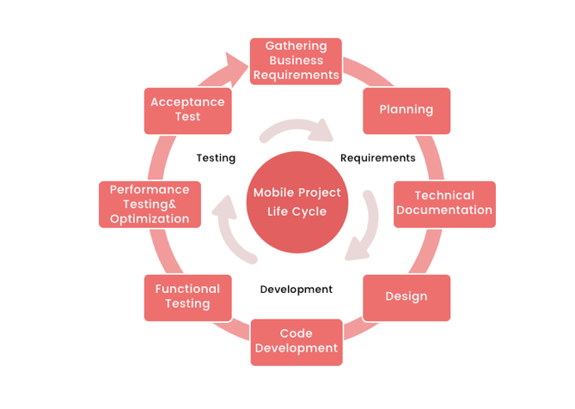
2.4 Mobile App Development Life Cycle
The lifecycle of mobile development is largely no different than the SDLC for web or desktop applications. As with those, there are usually 6 stages of the process:

Slide 20
2.4 Mobile App Development Life Cycle continued..
1. Planning stage (project manager, marketer, and business analyst are involved) – carrying out the business analysis and crafting mobile strategy.
2. Technical documentation (covered by the technical writer) – describing all tech requirements and details.
3. Prototyping (usually made by a UX/UI designer) – creating the sketch, wireframes, prototype and final app skins upon approval.
4. Development (performed by the developers) – front-end and back-end segments of coding.
5. Quality Assurance (usually performed continuously after each agile sprint is completed; followed by bug fixing) – testing tech requirements, device compatibility, interface, security aspects, etc.
6. Publishing & Maintenance (covered by DevOps) – publishing to the app store, updates releases, infrastructure, and entire app maintenance.

Slide 21
2.5 Memory Management
Introduction
Memory management is the hardest part of mobile development. Mobile devices, from cheaper ones to the most expensive ones, have limited amount of dynamic memory compared to our personal computers.
While you’re developing your application; you need to take this constraint into consideration by freeing the resources you don’t need and minimize them not to destroy user experience. If you fail to manage your application’s memory resources which are provided by the operating system, that means you are going to face with random crashes, UI freezes and finally a bunch of angry users.
The Android Runtime (ART) and Dalvik virtual machine use paging and memory-mapping (mmapping) to manage memory. This means that any memory an app modifies—whether by allocating new objects or touching mmapped pages—remains resident in RAM and cannot be paged out. The only way to release memory from an app is to release object references that the app holds, making the memory available to the garbage collector.
Memory management in iOS was initially non-ARC (Automatic Reference Counting), where we have to retain and release the objects. Now, it supports ARC and we don't have to retain and release the objects. Xcode takes care of the job automatically in compile time.

